Slide 1
Lecture 3
How to minimize cost
Sung Kim <hunkim+mr@gmail.com>
http://hunkim.github.io/ml/

Slide 2
Acknowledgement
Andrew Ng’s ML class
https://class.coursera.org/ml-003/lecture
http://www.holehouse.org/mlclass/ (note)
Convolutional Neural Networks for Visual Recognition.
http://cs231n.github.io/
Tensorflow
https://www.tensorflow.org
https://github.com/aymericdamien/TensorFlow-Examples

Slide 3


Hypothesis and Cost

Slide 4


Simplified hypothesis

Slide 5
What cost(W) looks like?
x | Y
1 | 1
2 | 2
3 | 3
W=1, cost(W)=?

Slide 6


What cost(W) looks like?
x | Y
1 | 1
2 | 2
3 | 3
W=1, cost(W)=0
W=0, cost(W)=4.67
W=2, cost(W)=?

Slide 7
What cost(W) looks like?
W=1, cost(W)=0
W=0, cost(W)=4.67
W=2, cost(W)=4.67

Slide 8
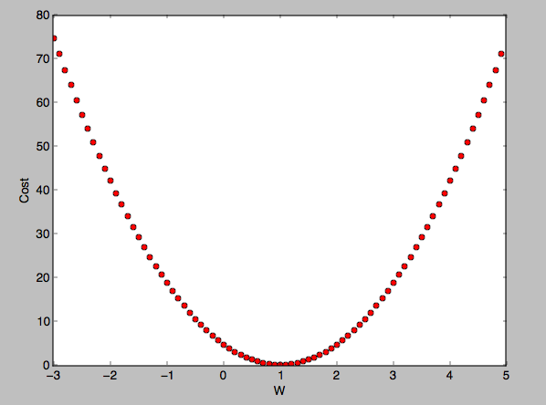
What cost(W) looks like?

Slide 9
How to minimize cost?

Slide 10
Gradient descent algorithm
Minimize cost function
Gradient descent is used many minimization problems
For a given cost function, cost (W, b), it will find W, b to minimize cost
It can be applied to more general function: cost (w1, w2, …)

Slide 11
How it works?
How would you find the lowest point?

Slide 12
How it works?
Start with initial guesses
Start at 0,0 (or any other value)
Keeping changing W and b a little bit to try and reduce cost(W, b)
Each time you change the parameters, you select the gradient which reduces cost(W, b) the most possible
Repeat
Do so until you converge to a local minimum
Has an interesting property
Where you start can determine which minimum you end up
http://www.holehouse.org/mlclass/01_02_Introduction_regression_analysis_and_gr.html

Slide 13


Formal definition

Slide 14

Formal definition

Slide 15



Formal definition

Slide 16
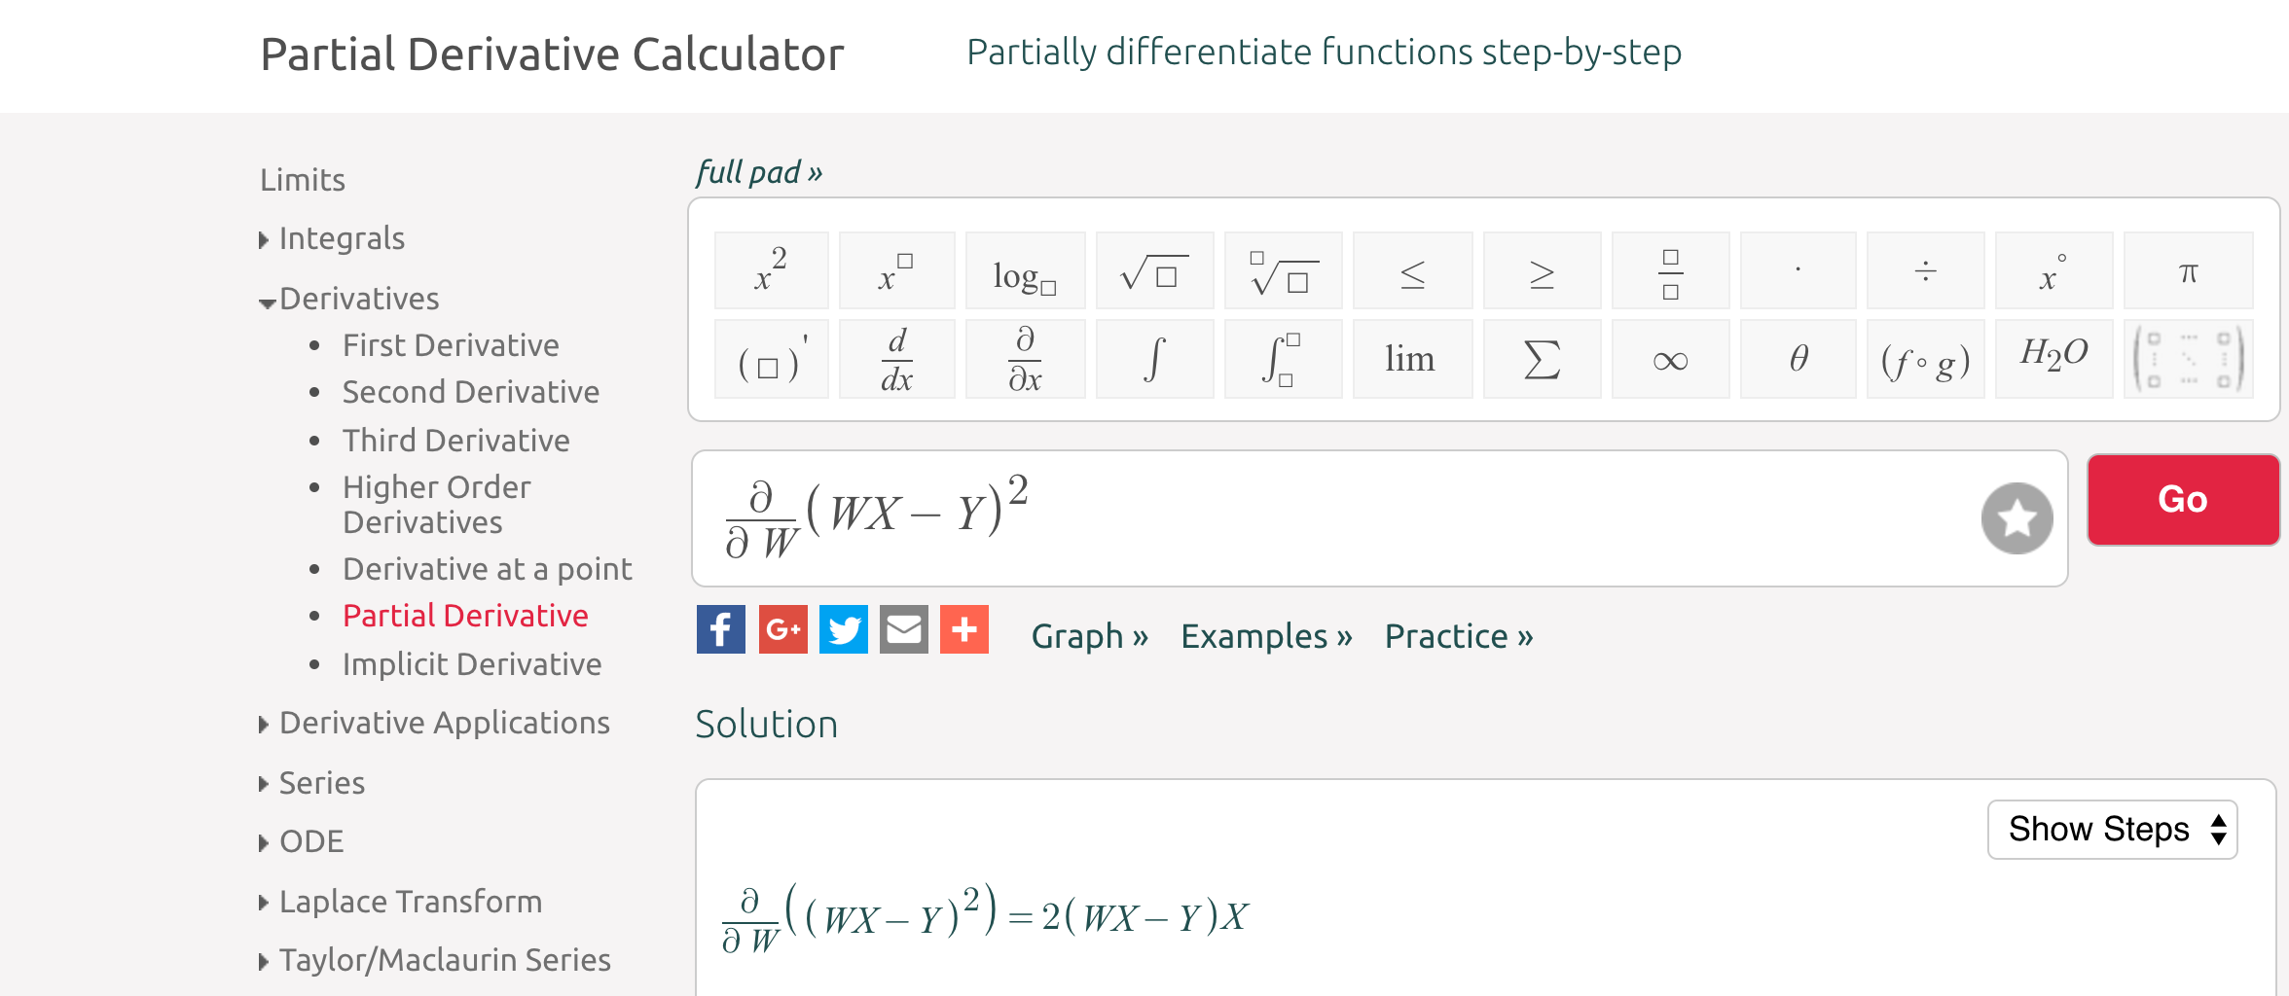
https://www.symbolab.com/solver/partial-derivative-calculator

Slide 17
Gradient descent algorithm

Slide 18
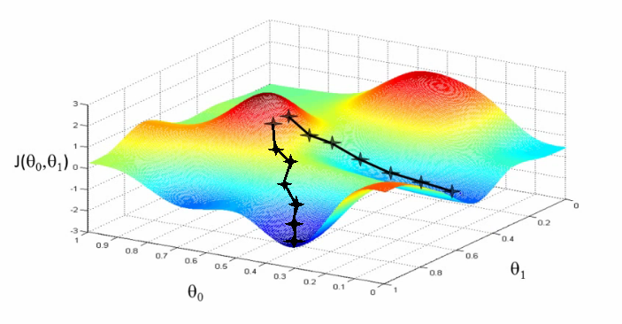

Convex function
www.holehouse.org/mlclass/

Slide 19
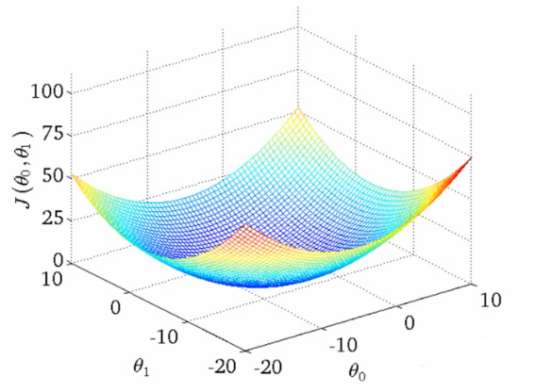
Convex function
cost(W, b)
W
b
www.holehouse.org/mlclass/

Slide 20

Next
Multivariable logistic regression

